Slide 1
Bigfoot Sightings
Ellis Chen

Slide 2
About the Dataset
Motivation?
What are common conditions for a big foot sighting
What does each observation represent?
Details about an individual report of a big foot sighting
What are we analyzing?
Seasons - categorical
Longitude & Latitude - quantitative
Wind Speed (mph) - quantitative
Cloud Coverage (%) - quantitative
Temperature ( ̊F) - quantitative
Humidity (%) - quantitative
Questions
Which season sees the greatest number of reports?
Is it possible to identify the locations of the most frequent sightings?

Slide 3
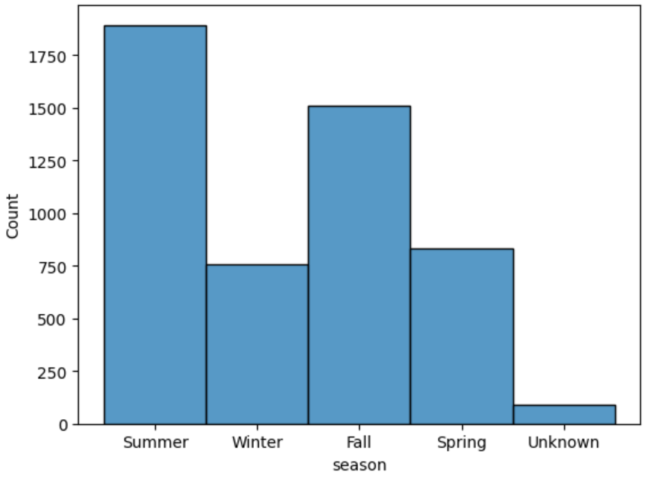
Frequency of Reports by Season

Slide 4
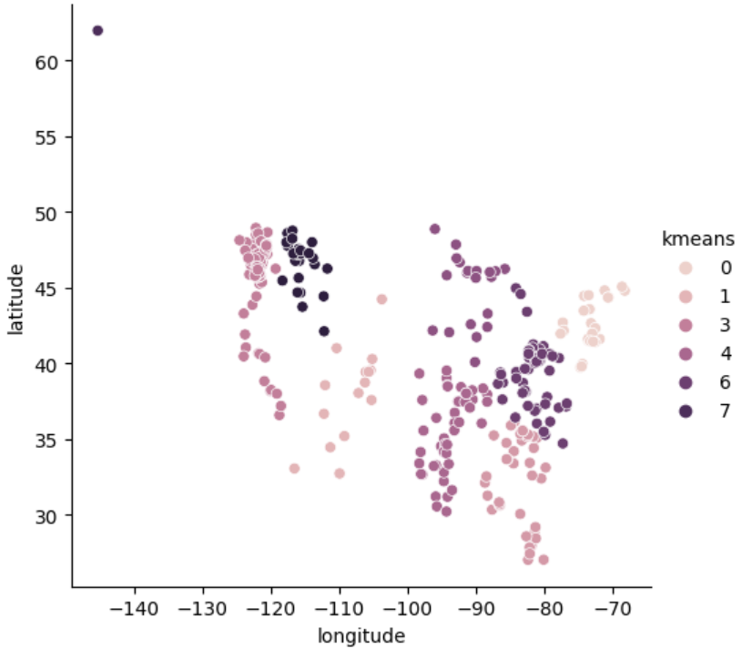
Clustering of Reported Locations

Slide 5
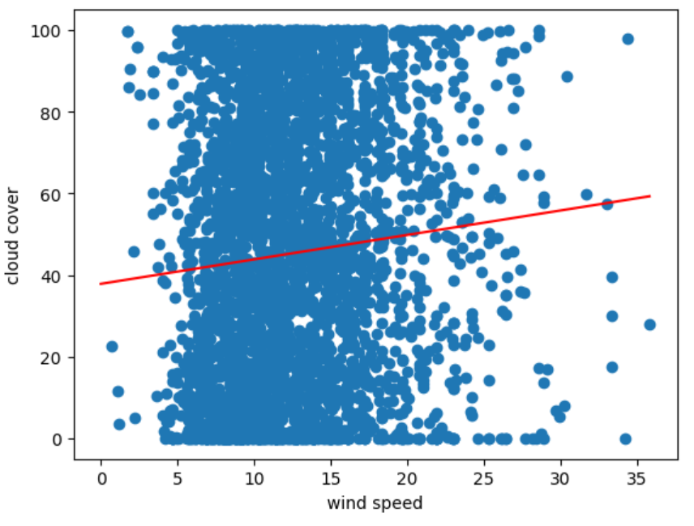
Wind Speed vs Cloud Coverage
Linear Regression:
Slope = 0.5987
Intercept = 37.8356
R-value = 0.0872
P-value = 0.0000002

Slide 6
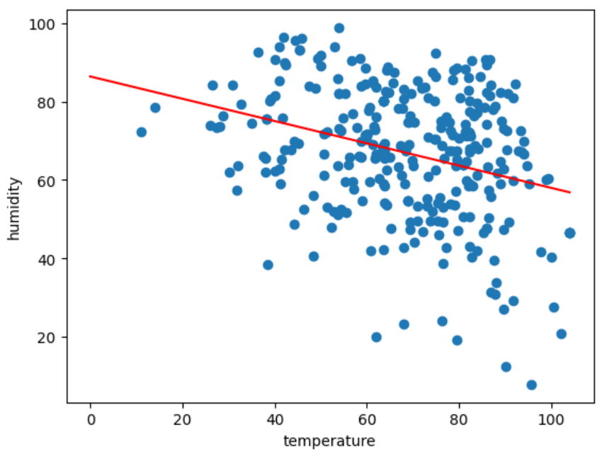
Temperature vs Humidity
Linear Regression:
Slope = -0.2843
Intercept = 86.4097
R-value = -0.31
P-value = 0.00000003

Slide 7
Conclusions
Frequency of reports by season from highest to lowest:
Summer -> Fall -> Spring -> Winter
We can use clustering methods to identify locations of most frequent sightings
There is a minor positive correlation between wind speed and cloud coverage
There is a negative correlation between temperature and humidity

